Slide 1

Northbridge Community Alliance
Volunteer Matching
&
Communication Assistant
Presenter: Karina
Team：Strategic Task Force

Slide 2
Department Needs and Application Vision
The Operational Bottleneck
The Critical Risk
Staff currently navigate a patchwork of spreadsheets to manually match volunteers. This slow process delays urgent community services and is prone to human error.
Accidentally assigning volunteers without mandatory, active certifications (e.g., Background Checks for youth programs) exposes Northbridge to severe safety and compliance liabilities.
The Vision
Target Users
Build an AI assistant that turns a manager’s natural language request into fast, 100% policy-compliant staffing decisions and ready-to-send communications in seconds.
Primary Users
Secondary Users
Program Managers & Volunteer Coordinators
(for day-to-day staffing).
Operations Leadership
(for capacity gap insights)

Slide 3
Value Proposition
Efficiency Gains (Time Savings)
Reduces manual coordination time from 30+ minutes of spreadsheet cross-referencing to less than 5 seconds.
Strategic Planning Visibility
Logs unmet demand and exact constraint reasons (e.g., certification gaps or short notice) to inform future volunteer recruitment and training strategies.
Risk Reduction & Compliance
Eliminates AI "Hallucination Risk." Deterministic code strictly enforces "no-exception" rules
(e.g., active Background Checks, Food Safety certs)
to prevent severe safety liabilities before mistakes happen.
Enhanced Reliability
Suggests actionable alternatives when constraints cannot be met and generates context-aware, brand-compliant emails based on Northbridge templates.
Fairness & Volunteer Retention
Automatically tracks weekly hours and prioritizes under-utilized volunteers, actively preventing volunteer burnout.

Slide 4


Application Architecture
Structured Extraction (LLM)
Input: Manager’s free-text request.
Action: The LLM acts purely as a parser, converting unstructured needs into a clean, structured JSON object (Role, Date, Time Block, Languages).
Stage 1
Deterministic Gatekeeping (Python / Pandas)
Why Code? To completely eliminate AI "Hallucination Risk" in decision-making.
Action: Python handles the core logic. It centralizes roster data and filters it against hard constraints (Availability, Minimum Notice Days, exact certification expiration dates, and weekly hour limits).
Stage 2
Stage 3
Automated Communication (LLM + PDF RAG)
Action: The system uses pdfplumber to dynamically extract official templates directly from the Northbridge Manual. The LLM then uses this context to draft a highly professional, corporate-grade response (Template 1 or 3).

Slide 5
Guardrails, Risk Mitigation & Responsible AI Design
Fairness & Volunteer Burnout
Privacy and Sensitive Volunteer Data
Operational
Edge Cases &
Silent Failures
Hallucination & Safety Exposure
Mitigation:
Matching is strictly delegated to deterministic Python logic, not the LLM. The system physically blocks unsafe assignments by parsing exact YYYY-MM-DD strings to ensure mandatory certifications (e.g., Background Checks) are present and unexpired.
Mitigation:
Employs "Utilization Balancing." The code tracks active assignments and sorts eligible volunteers by current weekly hours (ascending order) to prioritize under-utilized candidates.
Mitigation:
Applies strict "Data Minimization." The system only outputs operationally necessary fields (Name, Contact, Languages), automatically redacting sensitive internal notes and home addresses from the final output.
Mitigation:
Transparent Escalation. Instead of failing silently when no match is found, the system generates a "Template 3" internal memo stating the exact constraint (e.g., "Missing Certifications") and suggests actionable adjustments for staff leads.

Slide 6

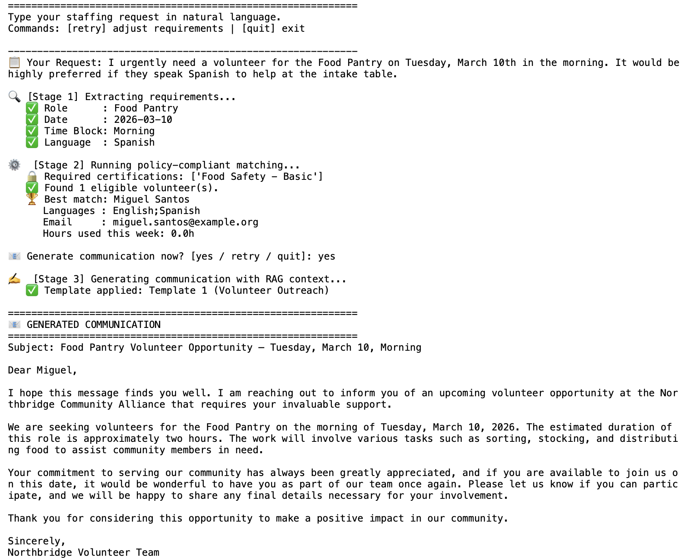
Prototype Demonstration
Scenario 1: Operational Efficiency (The Happy Path)
Request: Urgent Spanish-speaking volunteer for Food Pantry.
Result: System validates Food Safety certification, matches Miguel Santos, and generates an outreach email (Template 1).
Interactive Conversation Loop: Real-time visibility into Stage 1 (Parsing), Stage 2 (Matching), and Stage 3 (Drafting).
Human-in-the-loop Guardrail: The system explicitly pauses to ask "Generate communication now?" before drafting any emails, ensuring final human oversight.
Tone & Style Control: Enforces formal business paragraphs and strict brand compliance, avoiding robotic or casual outputs.

Slide 7
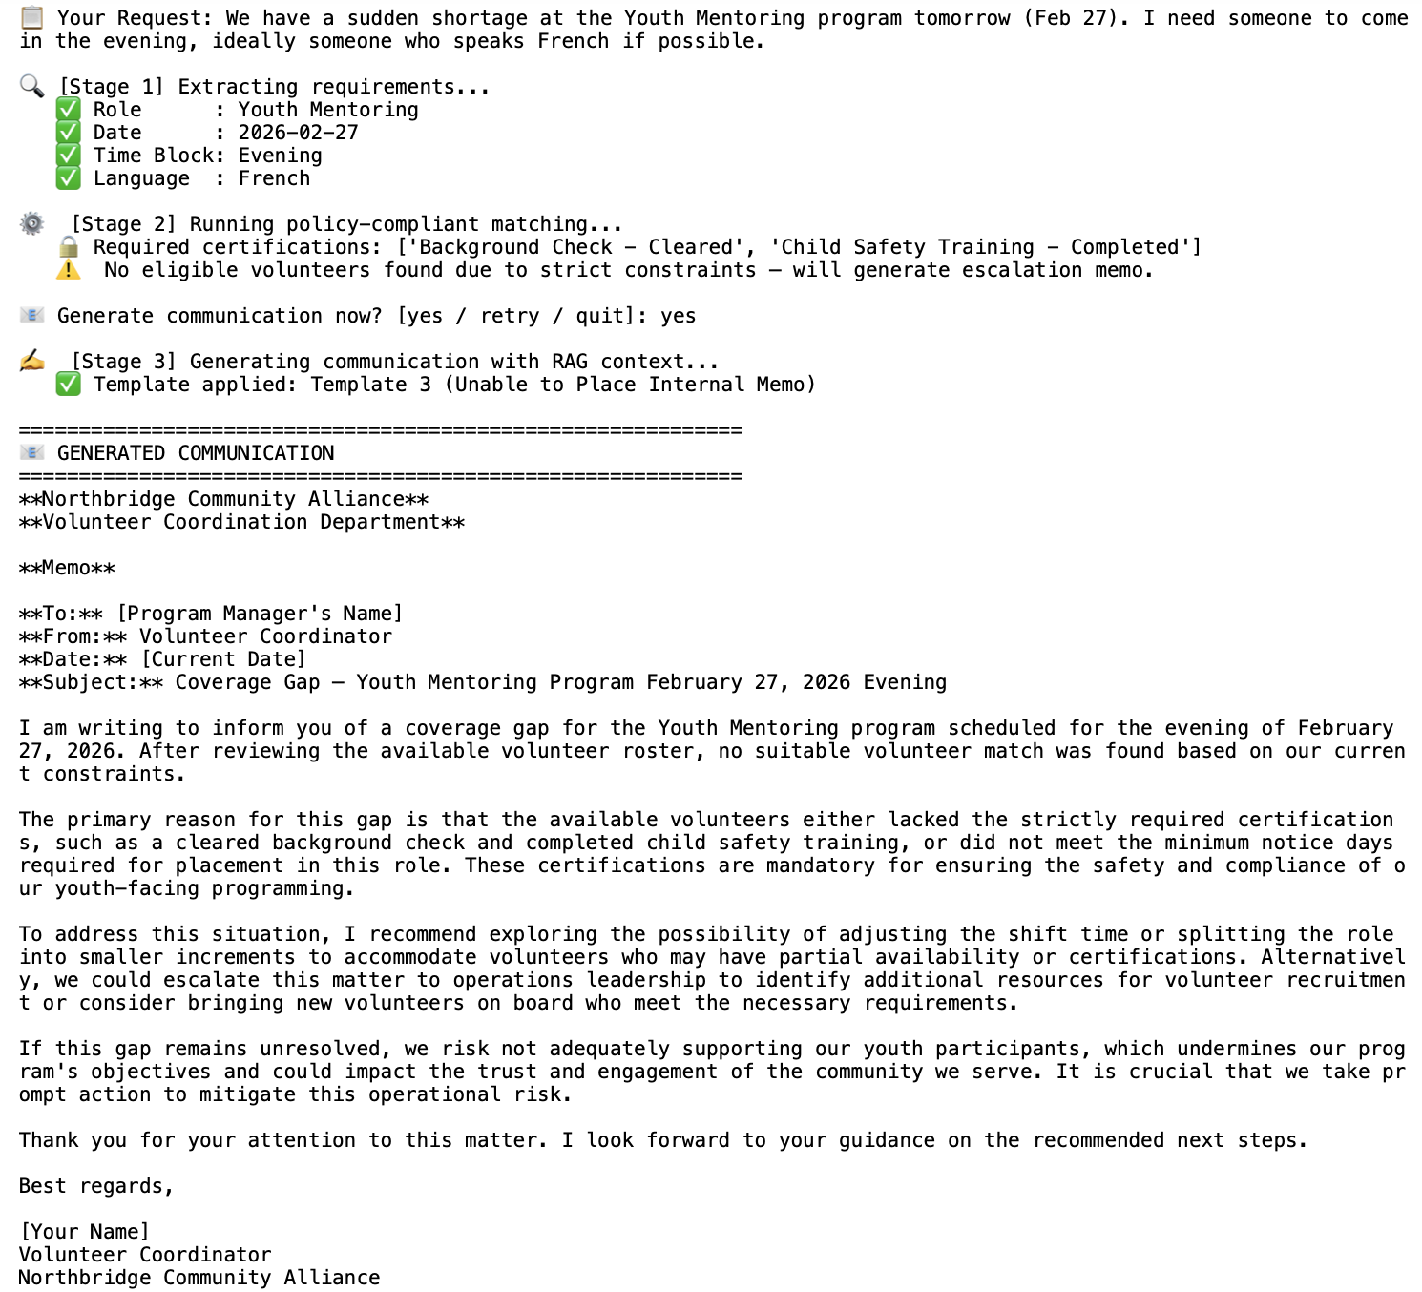
Prototype Demonstration
Scenario 2: Compliance Gatekeeping (The Edge Case)
Request: Urgent French-speaking volunteer for Youth Mentoring.
Result: System finds an available candidate but physically blocks the match because strictly required certifications (Background Check & Child Safety) are missing.
Human-in-the-Loop (UX): The system explicitly pauses (Generate communication now?) to ensure human oversight before drafting any internal documents.
Corporate-Grade Escalation: RAG injection ensures the generated memo uses a highly professional, objective tone to explain the coverage gap to leadership.

Slide 8
Current Implementation Challenges & Mitigations
Data inconsistency in roster inputs
(e.g., case sensitivity like "morning" vs "Morning").
Mitigation: Implemented defensive programming (e.g., .lower() string parsing) within the Python logic to ensure robust and accurate filtering.
Overusing the "best fit" volunteers, leading to potential burnout.
Mitigation: Hardcoded a utilization balancing algorithm. The system dynamically calculates current_weekly_hours and sorts eligible volunteers in ascending order to prioritize those with fewer scheduled shifts.

Slide 9
Future Integration & Scalability
Calendar API Integration
Advanced Vector-Based RAG (ChromaDB/FAISS)
Connect directly to scheduling systems (e.g., Google Calendar/Outlook) for real-time conflict checks and one-click volunteer invites.
Upgrade the current pdfplumber lightweight parser to a scalable vector database. This will allow the system to cite the exact page and paragraph numbers from the coordination manual in every escalation memo for total transparency.
A/B Testing
Optimize AI-generated outreach messaging to track which email variations yield the highest volunteer confirmation rates.
Omnichannel Routing (SMS Integration)
Integrate SMS gateway APIs (e.g., Twilio) to automatically route outreach messages based on a volunteer’s preferred_contact field, significantly reducing response times for urgent shifts.
Capacity Analytics Dashboard
Aggregate data from "Template 3" refusal reasons to identify systemic gaps (e.g., "consistent shortage of child safety certified volunteers") and guide targeted recruiting.

Slide 10
Northbridge Community Alliance
Thank You
Volunteer Matching & Communication Assistant
Presenter: Karina
Team：Strategic Task Force

